Slide 1
App to App Communication Developer’s Guide to Windows 10

Slide 2
Agenda
App to App in Windows 10 UWP
URI and Protocol Activation
Share Contract
URI Activation to a Specific App
Send Files
Query Uri Support
App Services
Shared Storage
Publishers’ Shared Storage Folder

Slide 3
App to App in Windows 10 UWP

Slide 4
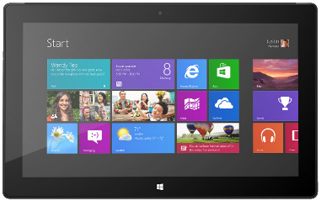


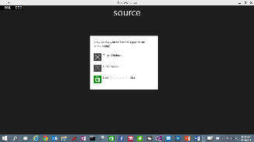
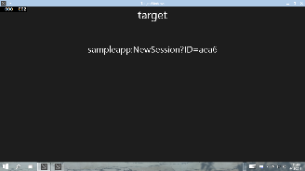





URI/Protocol Activation (also in Windows 8.1)
Launcher.LaunchUriAsync(new Uri("sampleapp:?ID=aea6"));
Launcher.LaunchFileAsync(file);
Data in Uri/File
User/OS chooses target

Slide 5
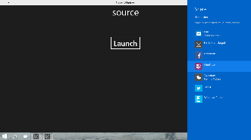



Share Contract (also in Windows 8.1)
DataTransferManager.ShowShareUI();
Share DataPackage
User chooses target

Slide 6

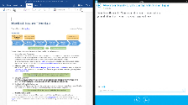

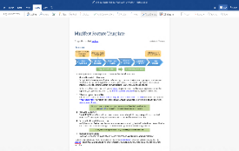
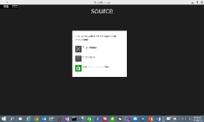

Enhanced App to App in Windows 10
Launch a *specific* app
Send file token, send data
Launch for Results
App Services

Slide 7
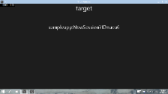


URI Activation++
Invoke a specific app
var options = new LauncherOptions();
options.TargetApplicationPackageFamilyName = "24919.InstapaperIt";
var launchUri = new Uri("instapaper:?AddUrl=http%3A%2F%2Fbing.com");
await Launcher.LaunchUriAsync(launchUri, options);

Slide 8
URI Activation++
Send Files
var options = new LauncherOptions();
options.TargetApplicationPackageFamilyName = "24919.InstapaperIt";
var token = SharedStorageAccessManager.AddFile (gpxFile);
ValueSet inputData = new ValueSet();
inputData.Add("Token", token);
var launchUri = new Uri("instapaper:?AddUrl=http%3A%2F%2Fbing.com");
await Launcher.LaunchUriAsync(launchUri, options, inputData);

Slide 9
Query URI Support
Discover if app already installed to handle a Uri
var queryUri = new Uri("instapaper:");
await Launcher.QueryUriSupportAsync(queryUri, LaunchUriType.LaunchUri);
var queryUri = new Uri("instapaper:");
string packageFamilyName = "24919.InstapaperIt";
await Launcher.QueryUriSupportAsync(queryUri, LaunchUriType.LaunchUriForResults, packageFamilyName);
?

Slide 10

App Services Covered in separate module
Client App A
App with App Service
Client App B
Background Task

Slide 11
URI Activation for Device Settings
Category | Settings page | Mobile and/or Desktop | Uri
System | Display (on desktop) Screen (on mobile) | Both | ms-settings:display
 | Notifications | Both | ms-settings:notifications
 | Storage Sense | Desktop only | ms-settings:storagesense
 | Battery Saver | Both | ms-settings:batterysaver
 | Offline Maps | Both | ms-settings:maps
Devices | Bluetooth | Both | ms-settings:bluetooth
Network and Wi-fi | Wi-Fi | Mobile Desktop | ms-settings:wifi ms-settings:network-wifi
 | Airplane mode | Mobile Desktop | ms-settings-airplanemode: ms-settings:network-airplanemode
 | Cellular | Both | ms-settings:network-cellular
 | Data Sense | Both | ms-settings:datausage
 | Proxy | Desktop only | ms-settings:network-proxy
More… [See documentation for complete list]

Slide 12
Demo: URI Activation in UWP

Slide 13
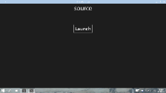

Launch for Results
Launching the app
var options = new LauncherOptions();
options.TargetApplicationPackageFamilyName = "24919.Instap";
var launchUri = new Uri("instapaper:?AddUrl=http%3A%2F%2Fbing.com");
await Launcher.LaunchUriForResultsAsync(launchUri, options, data);
var resultData = new ValueSet();
resultData.Add("Result", value);
operation.ProtocolForResultsOperation.ReportCompleted(resultData);A
App1
App2

Slide 14
Demo: Launch for Results

Slide 15
Publisher’s Shared Storage Folder

Slide 16
Apps from the same publisher share files and settings

Slide 17
Publisher’s shared storage folder
A subfolder is required. Edit app manifest to add. Folders are automatically provisioned.
<Package> <Extensions>
<Extension Category="windows.publisherCacheFolder"> <PublisherCacheFolder> <Folder Name="Folder1"> </PublisherCacheFolder> </Extension>
</Extensions> </Package>

Slide 18
Shared storage folder interaction
Access folder named “fonts”:
Windows.Storage.ApplicationData.Current .GetPublisherCacheFolder("fonts");
Clear shared storage:
Windows.Storage.ApplicationData.Current .ClearPublisherCacheFolderAsync();

Slide 19
Review
App to App in Windows 10 UWP
URI and Protocol Activation
Share Contract
URI Activation to a Specific App
Send Files
Query Uri Support
App Services
Shared Storage
Publishers’ Shared Storage Folder

